Slide 1
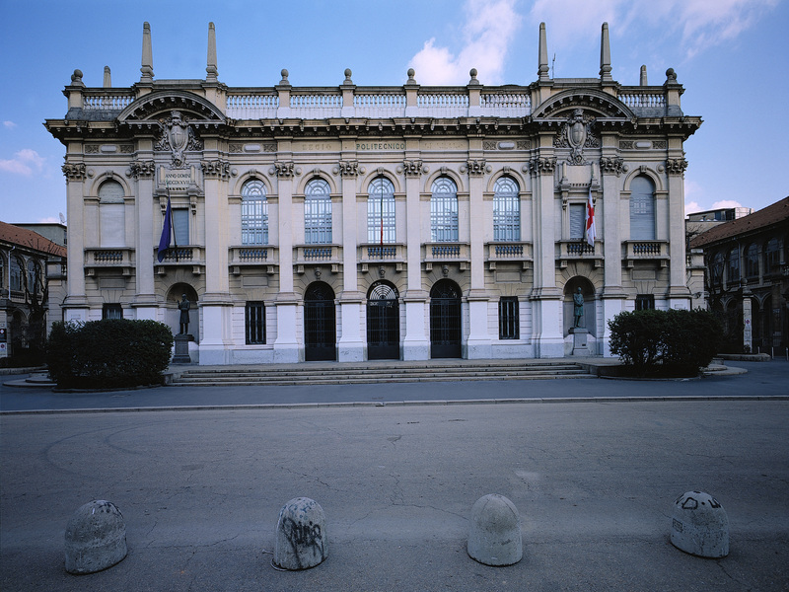

Titolo presentazione sottotitolo
Future Worlds 3D
Milano, XX mese 20XX
Creative Programming and Computing – Project presentation
Students : Harry Foley, Eray Özgünay , Emanuele Greco

Slide 2
Context
Inpiration
  World3 Model from Limits to Growth
Motivation
  Promote awareness of our control of our planet's future
Concept
  Bring data to life through audio visual creative computing techniques

Slide 3
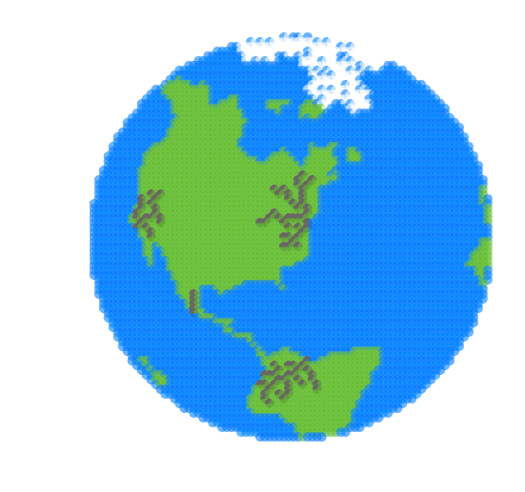

Hackathon
2D representation
OpenCV Edge detection

Slide 4
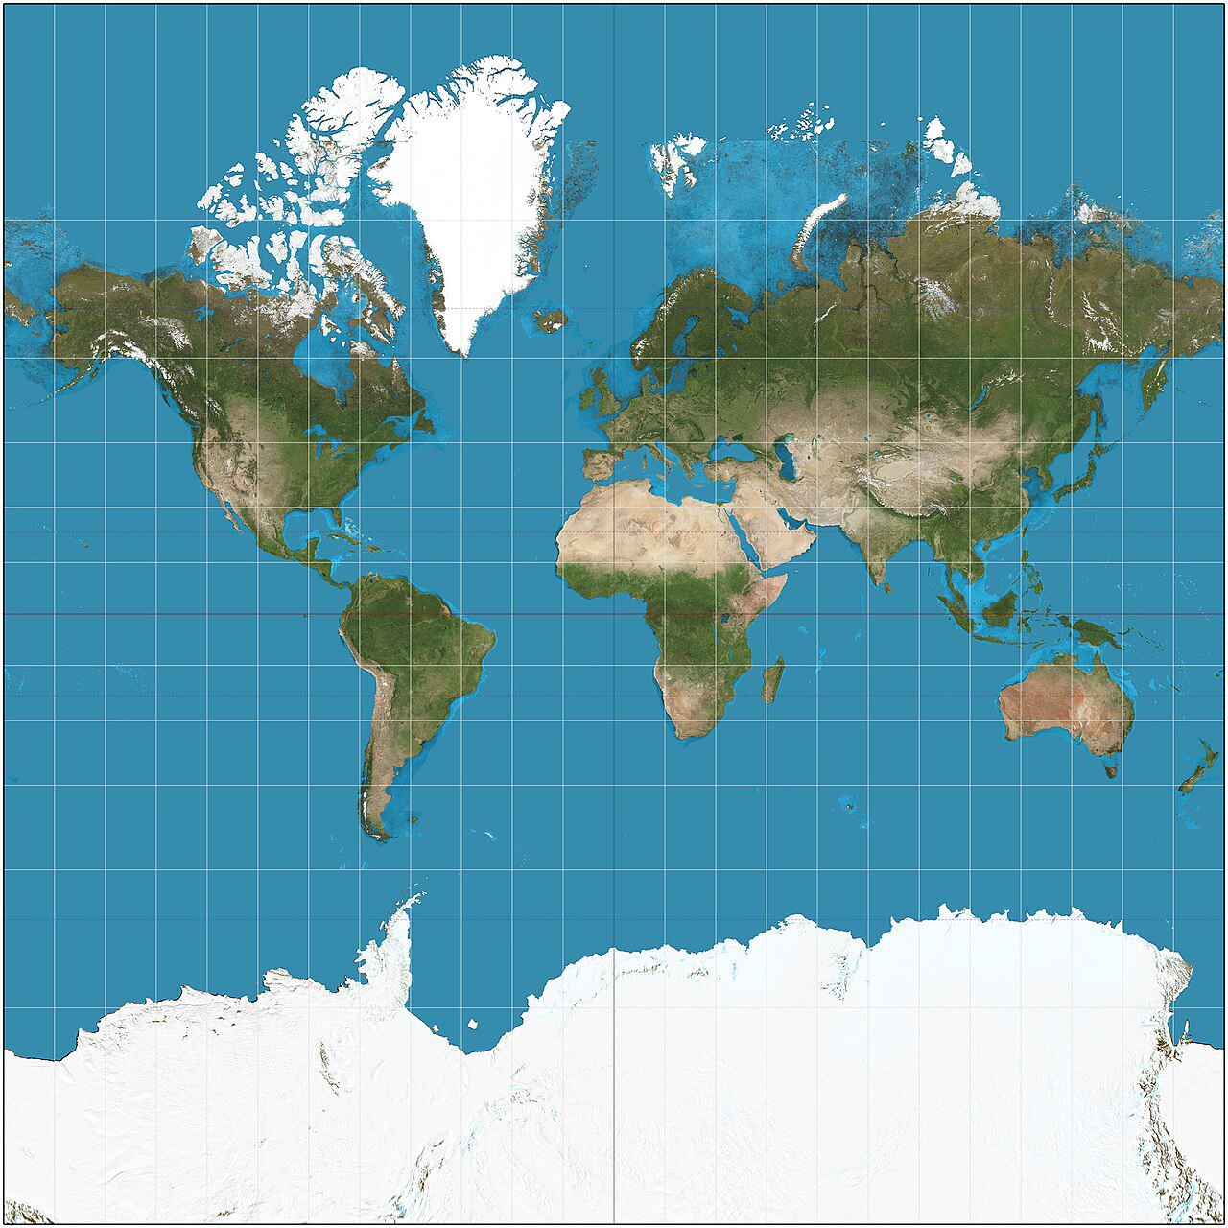
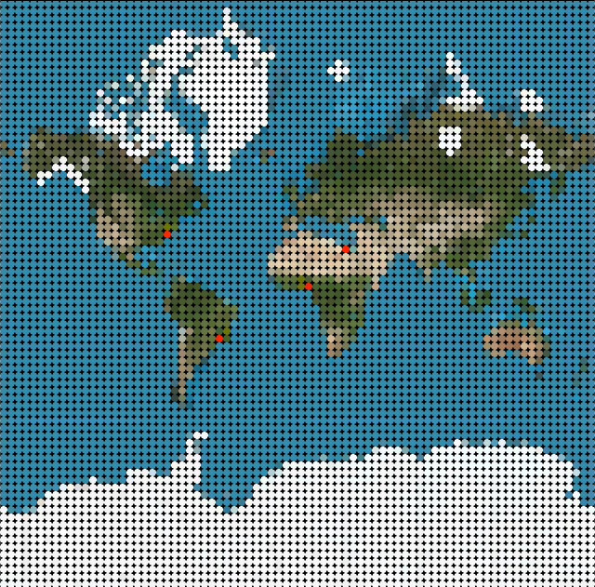
Step 1 - Image Input
Mercator Map to 2D Grid of Cells
Cell Type classified through HSB colour categorisation

Slide 5
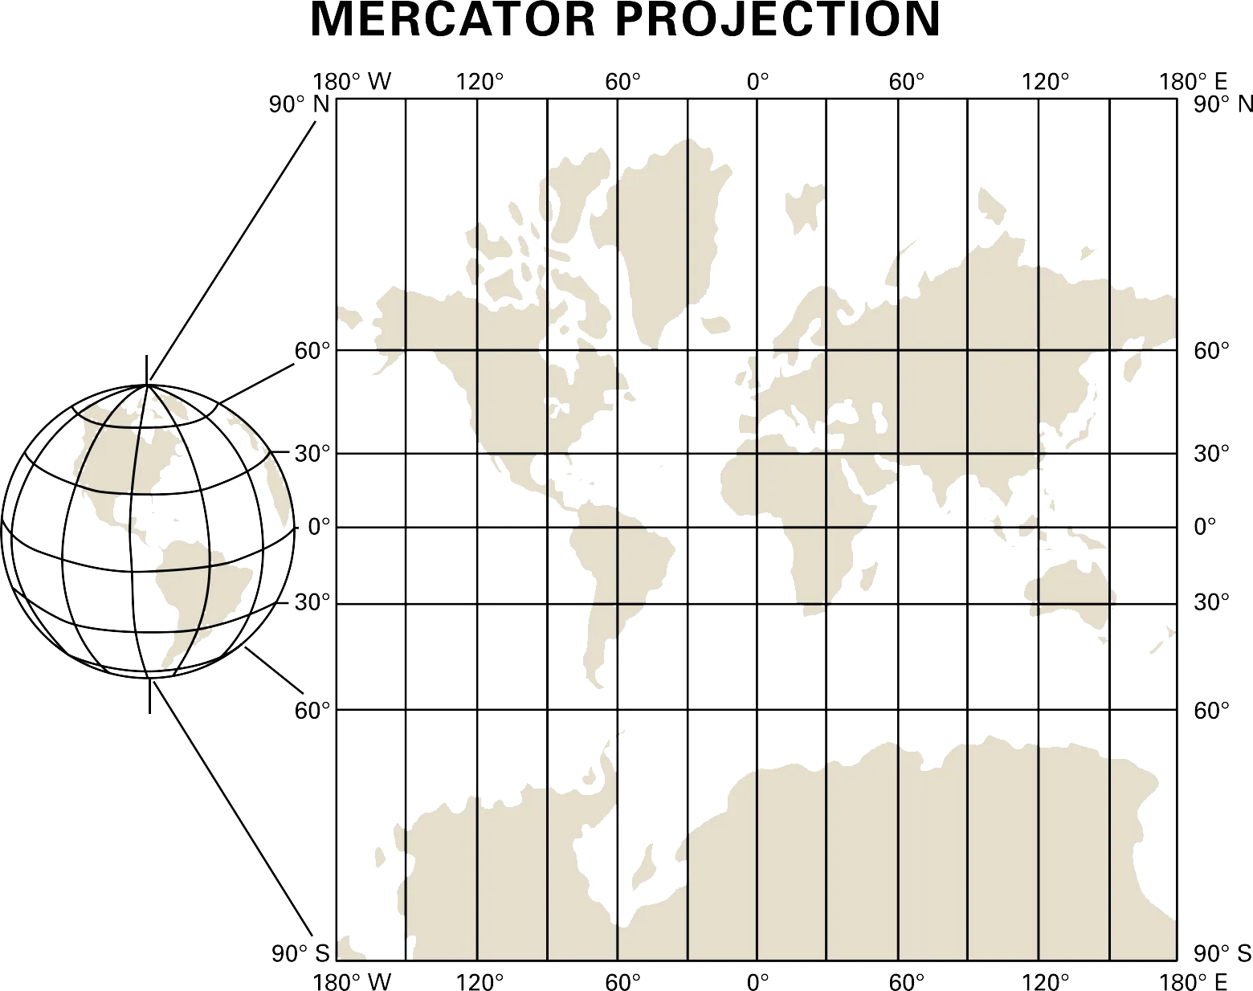
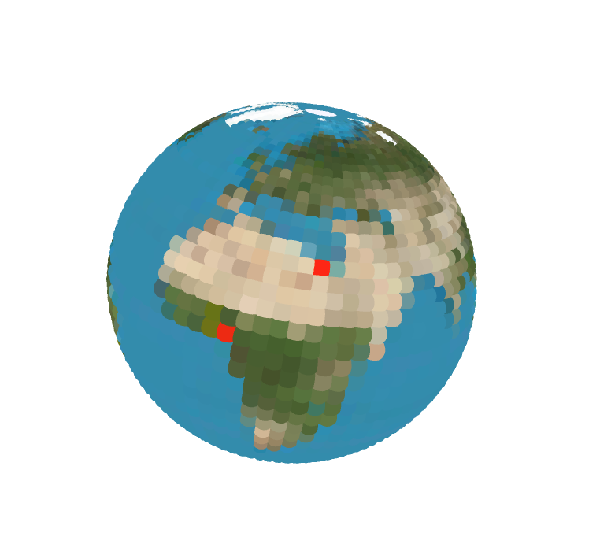
Step 2 - Two Dimensions to Three Dimensions
2D map projected onto a sphere:
  (X,Y) of image to (Longitude,Latitude)
  (Longitude,Latitude) to Sphere
  Cell size scaled by Longitude
Axis rotation through camera movement

Slide 6
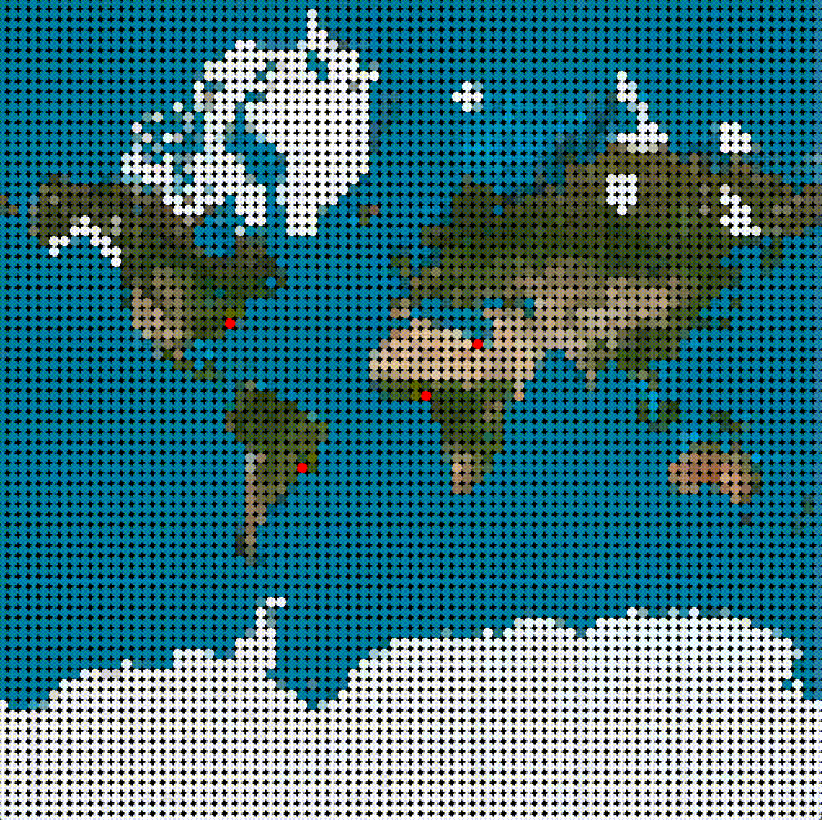
Step 3 - Automa Cellulare
Inspired by Conway's Game of Life
5 cell states to the power of 6400 cells
9 cell interaction rules
Rate of change proportional to time series data
Notes:
2.56 x 10 to the 4473

Slide 7
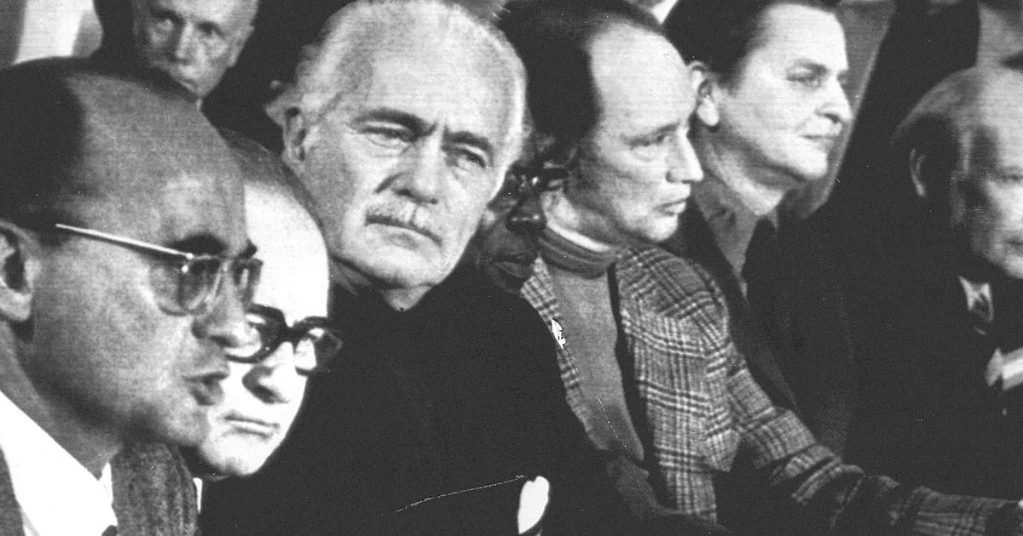
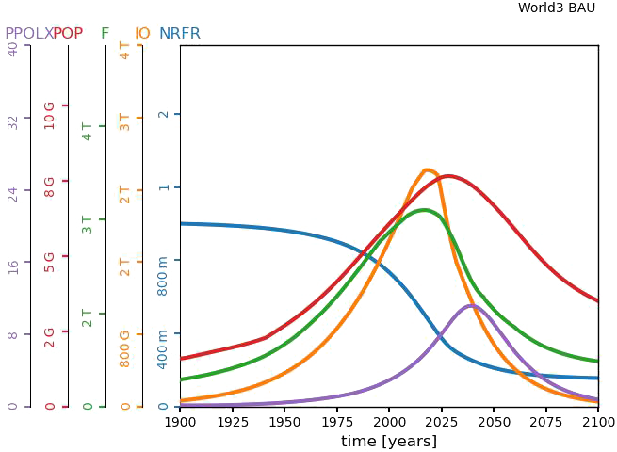
World3 Model
System dynamics model for the simulation of the world’s most important variables and their interaction in the ecosystems of the Earth
Source of time series data
Most convenient scenarios found through the use of a Genetic Algorithm

Slide 8
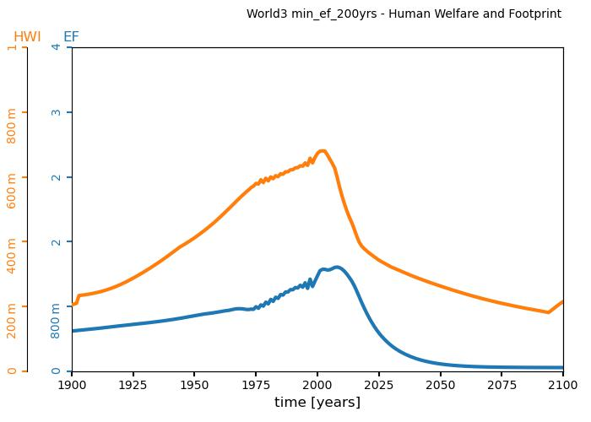
World3 Model
Examples of variables in use:
PPOLX: Persistent pollution index
F,FPC: Food [vegetable-equivalent kilograms/year], Food per capita
LE: Life expectancy
HWI: Human welfare index
EF: Human Ecological footprint

Slide 9
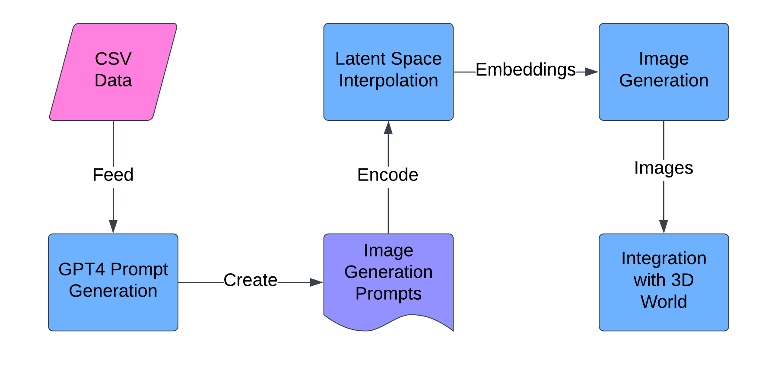
A.I. Image generation
GPT4 + CLIP + small-stable-diffusion-v0

Slide 10


Sound Design
Time series data packaged as OSC Messages
Controlling music and foley sounds in Ableton

Slide 11
Future improvements
Shaders for higher definition 3D model
Dynamic photo generation
Separate GUI screen

Slide 12
Thank You
Demo

